Slide 1
Finite-State Automata and Project 1
CS 236
Fall 2023

Slide 2
Overview and Due
Finite state automata
Elements of state machine definition
Parallel and max algorithm for project 1
Due
HW 3 due today
HW 4 due Wednesday
Project 1 due Tuesday, Sept 28
You can start project 1 today

Slide 3
Running a Finite State Machine
Traces

Slide 4
Project 1: FSM for “Rules” Datalog keyword
s₀
Let’s do a trace on two different inputs
R , λ
not R , fail
s₁
not u , fail
u , λ
s₂
not l , fail
s_{fail}
l , λ
not e , fail
s₃
not s , fail
e , λ
s₄
s , RULES
s₅

Slide 5
Project 1: FSM for “Rules” Datalog keyword
s₀
Let’s do a trace on two different inputs
R , λ
not R , fail
Input string
Output
s₁
Rules
not u , fail
u , λ
s₂
not l , fail
s_{fail}
l , λ
not e , fail
s₃
not s , fail
e , λ
s₄
s , RULES
s₅

Slide 6
Project 1: FSM for “Rules” Datalog keyword
s₀
Let’s do a trace on two different inputs
R , λ
not R , fail
Input string
Output
s₁
Rules
not u , fail
u , λ
s₂
not l , fail
s_{fail}
l , λ
not e , fail
s₃
not s , fail
e , λ
s₄
s , RULES
s₅

Slide 7
Project 1: FSM for “Rules” Datalog keyword
s₀
Let’s do a trace on two different inputs
R , λ
not R , fail
Input string
Output
s₁
Rules
not u , fail
u , λ
s₂
not l , fail
s_{fail}
l , λ
not e , fail
s₃
not s , fail
e , λ
s₄
s , RULES
s₅

Slide 8
Project 1: FSM for “Rules” Datalog keyword
s₀
Let’s do a trace on two different inputs
R , λ
not R , fail
Input string
Output
s₁
Rules
not u , fail
u , λ
s₂
not l , fail
s_{fail}
l , λ
not e , fail
s₃
not s , fail
e , λ
s₄
s , RULES
s₅

Slide 9
Project 1: FSM for “Rules” Datalog keyword
s₀
Let’s do a trace on two different inputs
R , λ
not R , fail
Input string
Output
s₁
Rules
not u , fail
u , λ
s₂
not l , fail
s_{fail}
l , λ
not e , fail
s₃
not s , fail
e , λ
s₄
s , RULES
s₅

Slide 10
Project 1: FSM for “Rules” Datalog keyword
s₀
Let’s do a trace on two different inputs
R , λ
not R , fail
Input string
Output
s₁
Rules
λ
not u , fail
u , λ
s₂
not l , fail
s_{fail}
l , λ
not e , fail
s₃
not s , fail
e , λ
s₄
s , RULES
s₅

Slide 11
Project 1: FSM for “Rules” Datalog keyword
s₀
Let’s do a trace on two different inputs
R , λ
not R , fail
Input string
Output
s₁
Rules
λ
not u , fail
u , λ
s₂
not l , fail
s_{fail}
l , λ
not e , fail
s₃
not s , fail
e , λ
s₄
s , RULES
s₅

Slide 12
Project 1: FSM for “Rules” Datalog keyword
s₀
Let’s do a trace on two different inputs
R , λ
not R , fail
Input string
Output
s₁
Rules
λ
not u , fail
u , λ
s₂
not l , fail
s_{fail}
l , λ
not e , fail
s₃
not s , fail
e , λ
s₄
s , RULES
s₅

Slide 13
Project 1: FSM for “Rules” Datalog keyword
s₀
Let’s do a trace on two different inputs
R , λ
not R , fail
Input string
Output
s₁
Rules
λ
not u , fail
u , λ
s₂
not l , fail
s_{fail}
l , λ
not e , fail
s₃
not s , fail
e , λ
s₄
s , RULES
s₅

Slide 14
Project 1: FSM for “Rules” Datalog keyword
s₀
Let’s do a trace on two different inputs
R , λ
not R , fail
Input string
Output
s₁
Rules
λ
not u , fail
u , λ
s₂
not l , fail
s_{fail}
l , λ
not e , fail
s₃
not s , fail
e , λ
s₄
s , RULES
s₅

Slide 15
Project 1: FSM for “Rules” Datalog keyword
s₀
Let’s do a trace on two different inputs
R , λ
not R , fail
Input string
Output
s₁
Rules
RULES
not u , fail
u , λ
s₂
not l , fail
s_{fail}
l , λ
not e , fail
s₃
not s , fail
e , λ
s₄
s , RULES
s₅

Slide 16
Another input

Slide 17
Project 1: FSM for “Rules” Datalog keyword
s₀
Let’s do a trace on two different inputs
R , λ
not R , fail
Input string
Output
s₁
Rust
λ
not u , fail
u , λ
s₂
not l , fail
s_{fail}
l , λ
not e , fail
s₃
not s , fail
e , λ
s₄
s , RULES
s₅

Slide 18
Project 1: FSM for “Rules” Datalog keyword
s₀
Let’s do a trace on two different inputs
R , λ
not R , fail
Input string
Output
s₁
Rust
λ
not u , fail
u , λ
s₂
not l , fail
s_{fail}
l , λ
not e , fail
s₃
not s , fail
e , λ
s₄
s , RULES
s₅

Slide 19
Project 1: FSM for “Rules” Datalog keyword
s₀
Let’s do a trace on two different inputs
R , λ
not R , fail
Input string
Output
s₁
Rust
fail
not u , fail
u , λ
s₂
not l , fail
s_{fail}
l , λ
not e , fail
s₃
not s , fail
e , λ
s₄
s , RULES
s₅

Slide 20
Finite State Automaton
A cousin of a finite state machine

Slide 21
Formal definition (def 3 in §13.3.3)
A finite state automaton (FSA) is a tuple (S, I, s_{o}, F, f)
Finite set of states: S
Set of input characters: I
Start state: s_{o}
Set of final or accept states: F
Transition function: f: S ⨉ I ⟶ S

Slide 22
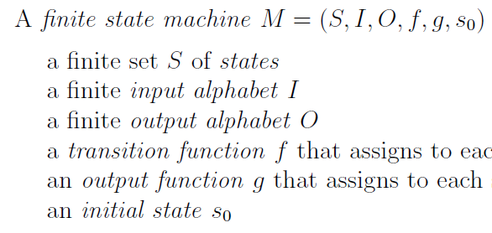
Formal definition (def 3 in §13.3.3)
A finite state automaton (FSA) is a tuple (S, I, s_{o}, F, f)
Finite set of states: S
Set of input characters: I
Start state: s_{o}
Set of final or accept states: F
Transition function: f: S ⨉ I ⟶ S

Slide 23
Formal definition (def 3 in §13.3.3)
A finite state automaton (FSA) is a tuple (S, I, s_{o}, F, f)
Finite set of states: S
Set of input characters: I
Start state: s_{o}
Set of final or accept states: F
Transition function: f: S ⨉ I ⟶ S
What’s the same?

Slide 24
Formal definition (def 3 in §13.3.3)
A finite state automaton (FSA) is a tuple (S, I, s_{o}, F, f)
Finite set of states: S
Set of input characters: I
Start state: s_{o}
Set of final or accept states: F
Transition function: f: S ⨉ I ⟶ S
What’s different?

Slide 25
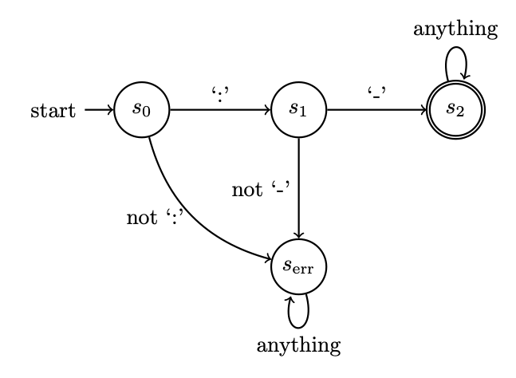
Example FSA
Tuple (S, I, s_{o}, F, f)
Finite set of states: S
Set of input characters: I
Start state: s_{o}
Set of final or accept states: F
Transition function: f: S ⨉ I ⟶ S

Slide 26
Practice

Slide 27
Design a finite state machine that outputs “COLON-DASH” only if the input string is “:-”
Design a finite state automaton that succeeds only if the input string is “:-”
Pattern
Pattern
Finite State Machine
Finite State Automaton
Specific
string
Specific
string
Output the
pattern name
Does that specific
string match that pattern

Slide 28
Design a finite state machine that outputs “COLON-DASH” only if the input string is “:-”
Design a finite state automaton that succeeds only if the input string is “:-”

Slide 29
Design a finite state machine that outputs “COLON-DASH” only if the input string is “:-”
Design a finite state automaton that succeeds only if the input string is “:-”
-, COLON-DASH
s₀
: , λ
s₂
s₁
not : , fail
not - , fail
s_{fail}

Slide 30
Design a finite state machine that outputs “COLON-DASH” only if the input string is “:-”
Design a finite state automaton that succeeds only if the input string is “:-”
-, COLON-DASH
s₀
: , λ
s₂
s₁
not : , fail
not - , fail
s_{fail}

Slide 31
Design a finite state machine that outputs “COLON-DASH” only if the input string is “:-”
Design a finite state automaton that succeeds only if the input string is “:-”
-, COLON-DASH
s₀
: , λ
s₂
s₁
not : , fail
not - , fail
s_{fail}

Slide 32
Example FSA
Tuple (S, I, s_{o}, F, f)
Finite set of states: S
Set of input characters: I
Start state: s_{o}
Set of final or accept states: F
Transition function: f: S ⨉ I ⟶ S
A double circle represents an accept state

Slide 33
FSA Trace
Input string
Output
:-

Slide 34
Regular Expressions and Finite State Automata

Slide 35
Two pattern manager tools
Regular Expressions
Finite State Automata
Pattern
Pattern
Regular Expression
Finite State Automaton
Specific
string
All strings matching
that pattern
Does that specific
string match that pattern

Slide 36
Practice with examples from today’s HW
Regular Expression
Finite State Automaton
Finite set of states: S
Set of input characters:
Start state: s_{o}
Set of final or accept states: F
Transition function: f: S ⨉ I ⟶ S

Slide 37
Practice with examples from today’s HW
Regular Expression
Finite State Automaton
Finite set of states: S
Set of input characters:
Start state: s_{o}
Set of final or accept states: F
Transition function: f: S ⨉ I ⟶ S
Discuss:
Accept states
Error state

Slide 38
Practice with examples from today’s HW
Regular Expression
Finite State Automaton
Finite set of states: S
Set of input characters:
Start state: s_{o}
Set of final or accept states: F
Transition function: f: S ⨉ I ⟶ S

Slide 39
Practice with examples from today’s HW
Regular Expression
Finite State Automaton
Finite set of states: S
Set of input characters:
Start state: s_{o}
Set of final or accept states: F
Transition function: f: S ⨉ I ⟶ S

Slide 40
Practice with examples from today’s HW
Regular Expression
Finite State Automaton
Finite set of states: S
Set of input characters:
Start state: s_{o}
Set of final or accept states: F
Transition function: f: S ⨉ I ⟶ S

Slide 41
Project 1 and FSAs

Slide 42
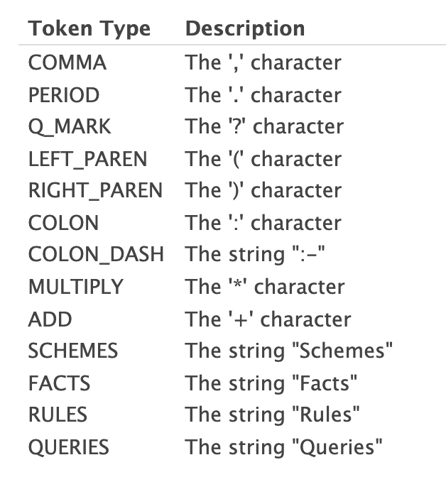
Datalog
Program
Lexer
Output
Schemes:
f(A,B)
g(C,D)
r(E,F)
Facts:
f('1','2').
f('4','3').
g('3','2').
r('1','4').
r('2','5').
r('3','5').
r('4','1').
Rules:
r(A,B) :- f(A,X),g(B,X).
f(C,D) :- r(D,C).
g(E,F) :- f(E,X),r(X,F).
Queries:
f('3',Z)?
r(Y,'3')?
f(W,X)?
(SCHEMES,"Schemes",1)
(COLON,":",1)
(ID,"f",2)
(LEFT_PAREN,"(",2)
(ID,"A",2)
(COMMA,",",2)
(ID,"B",2)
(RIGHT_PAREN,")",2)
(ID,"g",3)
(LEFT_PAREN,"(",3)
(ID,"C",3)
(COMMA,",",3)
(ID,"D",3)
(RIGHT_PAREN,")",3)
(ID,"r",4)
(LEFT_PAREN,"(",4)
(ID,"E",4)
(COMMA,",",4)
(ID,"F",4)
(RIGHT_PAREN,")",4)
(FACTS,"Facts",6)
(COLON,":",6)
(ID,"f",7)
(LEFT_PAREN,"(",7)
(STRING,"'1'",7)
(COMMA,",",7)
(STRING,"'2'",7)
(RIGHT_PAREN,")",7)
(PERIOD,".",7)
(ID,"f",8)
(LEFT_PAREN,"(",8)
(STRING,"'4'",8)
(COMMA,",",8)
(STRING,"'3'",8)
(RIGHT_PAREN,")",8)
(PERIOD,".",8)
(ID,"g",9)
(LEFT_PAREN,"(",9)
(STRING,"'3'",9)
Datalog program
Lexer
tokens

Slide 43
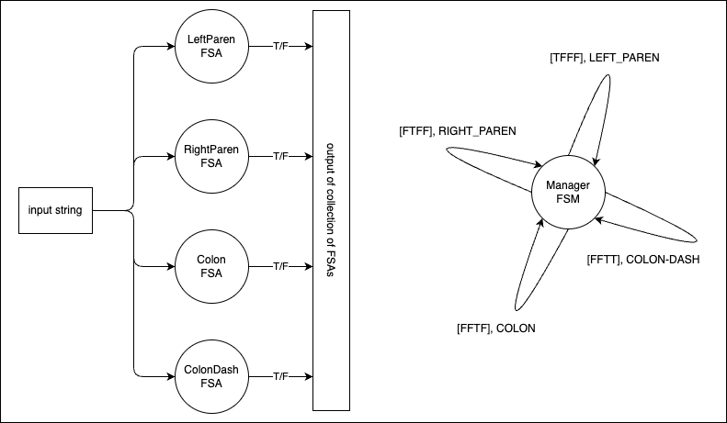
Lexer
The Lexer is made up of a set of FSAs,
one for each Datalog program pattern

Slide 44
Lexer
Schemes:
mike0(A,B)
g(C,D)
Facts:
mike0('1','2').
mike0('4','3').
g('3','2').
Rules:
Queries:
mike0('3',Z)?
g(‘3’,Z)?
Lexer
tokens
The input to the Lexer is a string.
Read the Datalog program into a string
Step each FSA through the Datalog string

Slide 45
Lexer
An example Datalog program that can be Lexed but won’t run (see Project 2)
:
:-
(
)
mike0
Lexer
tokens
The input to the Lexer is a string.
Read the Datalog program into a string
Step each FSA through the Datalog string

Slide 46
Lexer
The first character in the string
:
:-
(
)
mike0
Lexer
tokens
The input to the Lexer is a string.
Read the Datalog program into a string
Step each FSA through the Datalog string

Slide 47
Lexer
The first character in the string
:
:-
(
)
mike0
Lexer
tokens
Run FSA until it succeeds or fails

Slide 48
Lexer
The first character in the string
:
:-
(
)
mike0
Lexer
tokens
Run FSA until it succeeds or fails

Slide 49
Lexer
The first character in the string
:
:-
(
)
mike0
Lexer
tokens
Run FSA until it succeeds or fails
Rewind to start of string and run next FSA

Slide 50
Lexer
The first character in the string
:
:-
(
)
mike0
Lexer
tokens
Run FSA until it succeeds or fails
Rewind to start of string and run next FSA
Repeat

Slide 51
Lexer
The first character in the string
:
:-
(
)
mike0
Lexer
tokens
Run FSA until it succeeds or fails
Rewind to start of string and run next FSA
Repeat

Slide 52
Lexer
The first character in the string
:
:-
(
)
mike0
Lexer
tokens
Look at outputs from all FSAs
Choose which Token is correct

Slide 53
Lexer
Look at outputs from all FSAs
Choose which Token is correct

Slide 54
Lexer
The first character in the string
:
:-
(
)
mike0
Lexer
COLON
Output correct token

Slide 55
Lexer
The first character in the string
:
:-
(
)
mike0
Lexer
COLON
Output correct token
Reset all FSAs

Slide 56
Lexer
The first character in the string
:
:-
(
)
mike0
Lexer
COLON
Output correct token
Reset all FSAs
Advance to next part of string

Slide 57
Lexer
The first character in the string
:
:-
(
)
mike0
Lexer
tokens
Run FSA until it succeeds or fails
Rewind to start of string and run next FSA
Repeat

Slide 58
Lexer
Look at outputs from all FSAs
Choose which Token is correct

Slide 59
Lexer
The first character in the string
:
:-
(
)
mike0
Lexer
COLON
COLON-DASH
Output correct token
Reset all FSAs
Advance to next part of string

Slide 60
Implementing FSAs
See Jupyter notebook tutorials
FSA_code_example
Multiple_FSAS_using_inheritance
Project1_example_managing_multiple_FSAs

